Slide 1
Lecture 11 Merge Sort
Abrar Hasan
Lecturer
Dept. of Software Engineering
Daffodil International University

Slide 2
Merge Sort
The key to Merge Sort is merging two sorted lists into one, such that if you have two lists X and Y the resulting list is Z(z₁≤z₂≤…≤z_{m+n})
Example:
L₁ = { 3 8 9 } L₂ = { 1 5 7 }
merge(L₁, L₂) = { 1 3 5 7 8 9 }

Slide 3
Merging (cont.)
X:
3 | 10 | 23 | 54
Y:
1 | 5 | 25 | 75
Result:

Slide 4
Merging (cont.)
X:
3 | 10 | 23 | 54
Y:
 | 5 | 25 | 75
Result:
1

Slide 5
Merging (cont.)
X:
 | 10 | 23 | 54
Y:
 | 5 | 25 | 75
Result:
1 | 3

Slide 6
Merging (cont.)
X:
 | 10 | 23 | 54
Y:
 |  | 25 | 75
Result:
1 | 3 | 5

Slide 7
Merging (cont.)
X:
 |  | 23 | 54
Y:
 |  | 25 | 75
Result:
1 | 3 | 5 | 10

Slide 8
Merging (cont.)
X:
 |  |  | 54
Y:
 |  | 25 | 75
Result:
1 | 3 | 5 | 10 | 23

Slide 9
Merging (cont.)
X:
 |  |  | 54
Y:
 |  |  | 75
Result:
1 | 3 | 5 | 10 | 23 | 25

Slide 10
Merging (cont.)
X:
Y:
 |  |  | 75
Result:
1 | 3 | 5 | 10 | 23 | 25 | 54

Slide 11
Merging (cont.)
X:
Y:
Result:
1 | 3 | 5 | 10 | 23 | 25 | 54 | 75

Slide 12
Divide And Conquer
1.Divide: Divide the unsorted list into two sub lists of about half the size.
2.Conquer: Sort each of the two sub lists recursively until we have list sizes of length 1,in which case the list itself is returned.
3.Combine: Merge the two-sorted sub lists back into one sorted list.

Slide 13
Merge Sort Example
99 | 6 | 86 | 15 | 58 | 35 | 86 | 4 | 0

Slide 14
Merge Sort Example
99 | 6 | 86 | 15 | 58 | 35 | 86 | 4 | 0
99 | 6 | 86 | 15
58 | 35 | 86 | 4 | 0

Slide 15
Merge Sort Example
99 | 6 | 86 | 15 | 58 | 35 | 86 | 4 | 0
99 | 6 | 86 | 15
58 | 35 | 86 | 4 | 0
99 | 6
86 | 15
58 | 35
86 | 4 | 0

Slide 16
Merge Sort Example
99 | 6 | 86 | 15 | 58 | 35 | 86 | 4 | 0
99 | 6 | 86 | 15
58 | 35 | 86 | 4 | 0
99 | 6
86 | 15
58 | 35
86 | 4 | 0
99
6
86
15
58
35
86
4 | 0

Slide 17
Merge Sort Example
99 | 6 | 86 | 15 | 58 | 35 | 86 | 4 | 0
99 | 6 | 86 | 15
58 | 35 | 86 | 4 | 0
99 | 6
86 | 15
58 | 35
86 | 4 | 0
99
6
86
15
58
35
86
4 | 0
4
0

Slide 18
Merge Sort Example
99
6
86
15
58
35
86
0 | 4
Merge
4
0

Slide 19
Merge Sort Example
6 | 99
15 | 86
58 | 35
0 | 4 | 86
99
6
86
15
58
35
86
0 | 4
Merge

Slide 20
Merge Sort Example
6 | 15 | 86 | 99
0 | 4 | 35 | 58 | 86
6 | 99
15 | 86
58 | 35
0 | 4 | 86

Slide 21
Merge Sort Example
0 | 4 | 6 | 15 | 35 | 58 | 86 | 86 | 99
6 | 15 | 86 | 99
0 | 4 | 35 | 58 | 86

Slide 22
Merge Sort Example
0 | 4 | 6 | 15 | 35 | 58 | 86 | 86 | 99

Slide 23
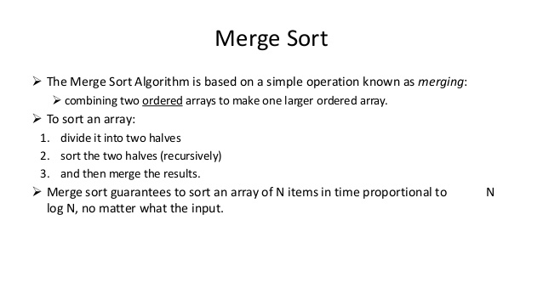
Merge

Slide 24
Questions?

Slide 25
Thank You

